Slide 1

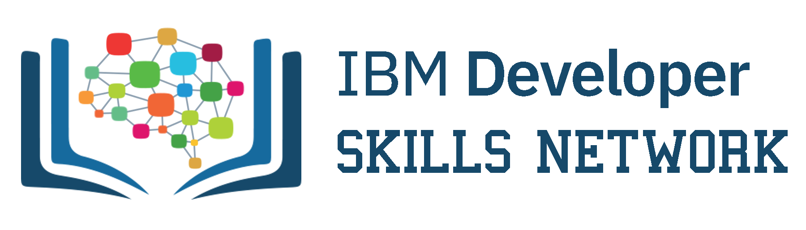
Languages and its Worldwide Usage
Kumud Prajapati
01st-April-2024

Slide 2
Outline
Executive Summary
Introduction
Methodology
Results
Discussion
Conclusion
Appendix
2

Slide 3
Executive Summary
To be competitive in the Global IT sector, it's essential to keep up with the ever-changing Technologies. This report uses Data Analytics to highlight current and projected trends in the need for skills related to programming languages, data basis and other Technologies. It also studies the demographics of professionals in the Technology Sector
Data was gather from stack overflow survey, IBM site, and GitHub job postings. It was collected, cleaned, subjected to Exploratory analysis, and visualized on dashboards.
The finding show that JavaScript as currently the most popular programming language and is anticipated to be so in the future MySQL has the highest database uses of the moment but Postgre SQL is projected to have more demand in the future.
Further more, of the survey response are male, are from the USA and are 28 years of age.
3

Slide 4
Introduction
This presentation reproduces Data Analytics to highlight current and projected friends in the need for skills related to programming languages, databases, Platforms and Web frames.
The following enquiry is very investigated using the data:
Which programming language are most in demand today?
What are the most in-demand database skills?
What popular IDEs or web frames are there?
That target audience for this research or it professionals, HR managers, and anybody else with an interest in the IT sector who wants to learn about the top on demand it skills in their respective sectors that will also still relevant in the future.
4

Slide 5
Methodology
Data server format such as the number of jobs currently available for different technology and for different places were gathered using the kit have jobs API on python.
To obtain the names of the programming languages in their early wages the IBM website was scraped. That datasheet from 2019 is tag overflow developer Survey was downloaded and saved.
Python was used to clean and analyze the data. To access the distribution at data the presence of outlets and the correlation between various columns in the data set and exploratory data analysis was carry out.
Chart, graphs and dashboards were created using Python and Cognos and electric visualize the data all the Python analysis were carried out on Jupiter notebook through Anaconda navigator
5

Slide 6
Results

Slide 7
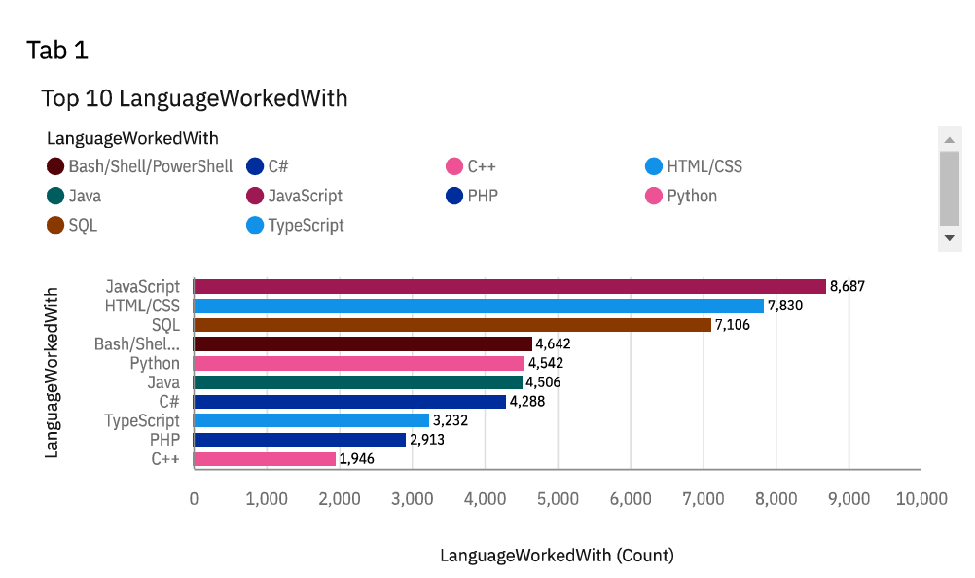
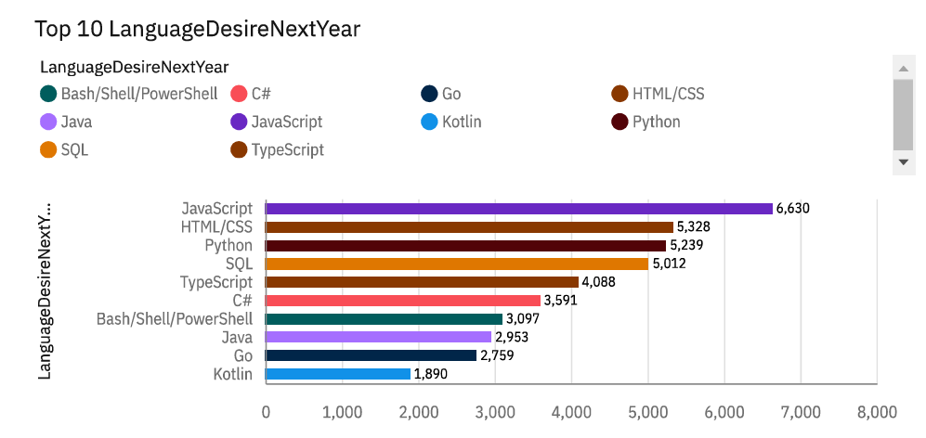
PROGRAMMING LANGUAGES TRENDS
Current Year
Next Year
7

Slide 8
Programming Languages trends- Findings and Implications
Findings
Implications
Javascript, html/CSS, SQL, shell languages and Python are the most use language is currently.
Javascript, html/css, SQL, and Typescript will be the most use languages next year and future years.
Python will have more demand then SQL next year
JavaScript and HTML are used for web development as a tech skill has the highest demand especially Typescript is getting viral.
Python is gaining more and more traction due to the increasing demand for AI and ml skills.
The most relevant language for data professionals. It is important for Aspiring data analyst, scientist, business analytic, etc to have SQL skills.
8

Slide 9
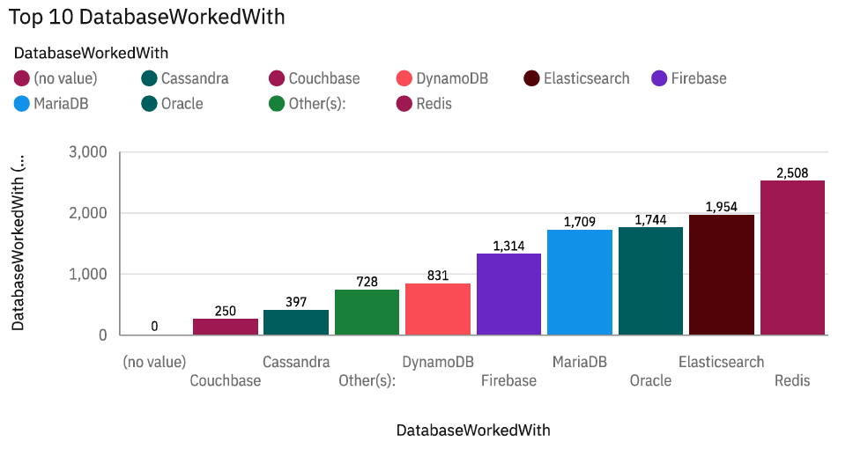
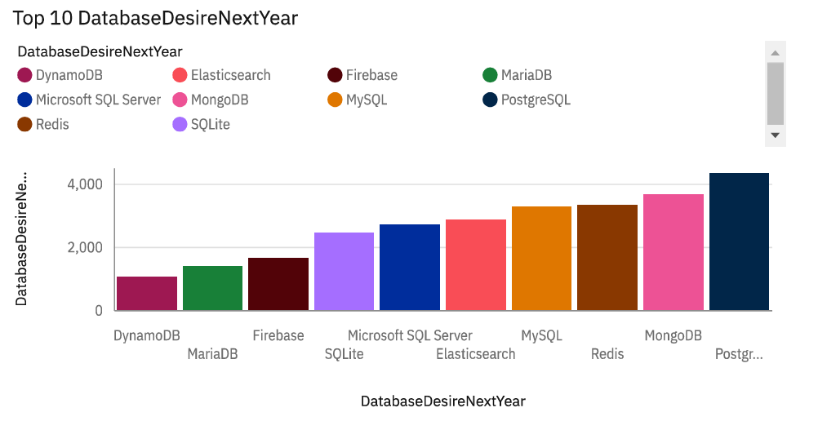
DATABASE TRENDS
Current Year
Next Year
9

Slide 10
Database trends- Findings and Implications
Findings
Implications
MySQL, Microsoft SQL server, PostgreSQL SQLite and MongoDB are the top 5 most used data bases at the moment.
However, PostgreSQL, MongoDB, redis MySQL and Elasticsense are project to become more popular in the future.
Redis and Elasticsense are relatively new tools and are set to gain more fraction in the IT Space.
SQL is still a top told to watch out for in data specialist
Companies still prefer open source databases.
Oracle SQL was not among the top 5. It is Losing relevance as time passes.
10

Slide 11
Dashboard
Dashboard Link:- https://github.com/Cyberghost91/IBM-Cognos-Analytics/blob/main/Languages%20and%20its%20Worldwide%20Usage.pdf
11

Slide 12
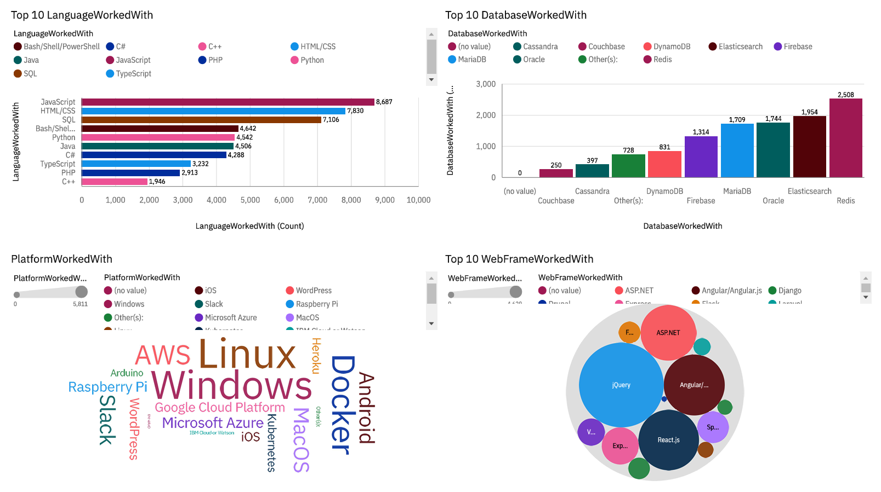
Dashboard 1
12

Slide 13
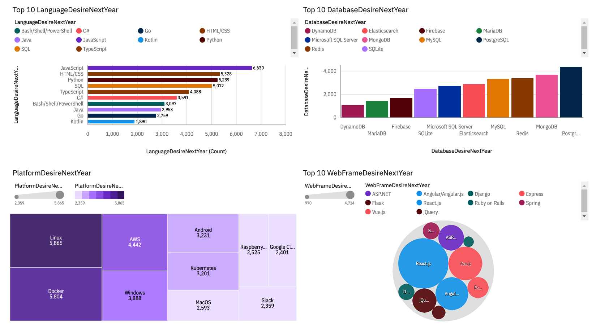
Dashboard 2
13

Slide 14
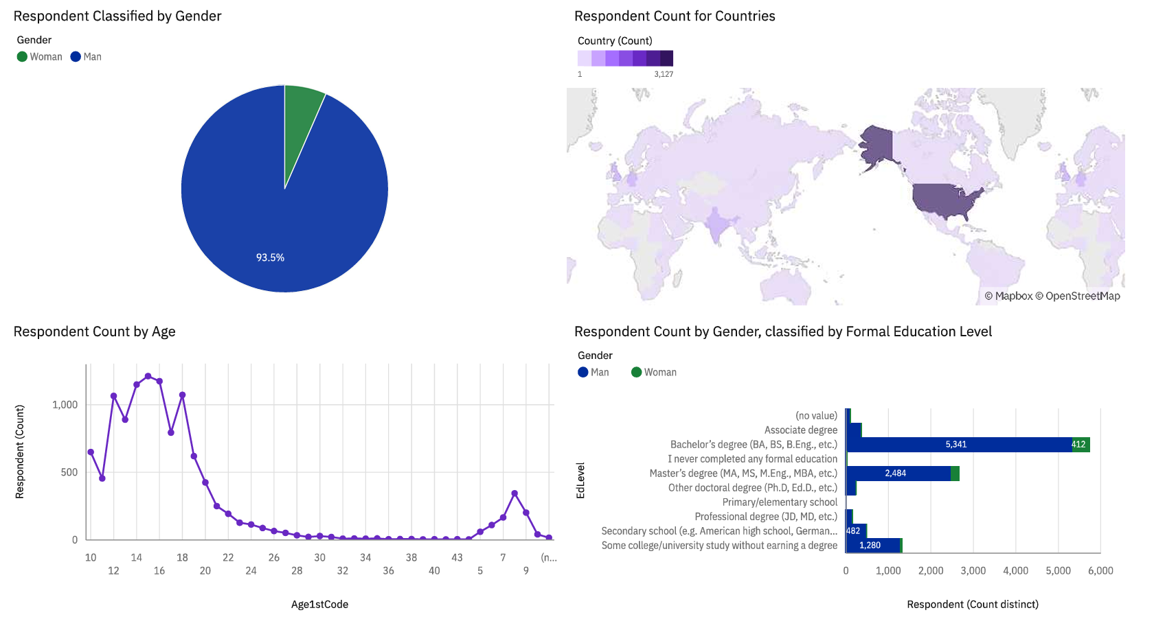
Dashboard 3
14

Slide 15
Discussion
Upskilling in the Technology Sector.
How do we close the white gender gap in the Technology Sector?
Is completing a Masters or doctorate a degree a requirement ?
The increasing demand for mobile development as Kotlin is getting popular
More take education, access and development in less developed reasons in south east asia, south America, africa and some parts of Europe.
How relevant will OracleSQL still be in the future?
15

Slide 16
Overall Findings and Implications
Findings
Implications
Most people in the ID field have a bachelor's degree.
Web development languages are the most popular and on demand tools in the IT field currently.
The IT sector is filled with majorly young people under 40 years of age.
Most respondents want to learn postgreSQL and React JSnext year.
It is important for data professionals to develop proficiency in NoSQL in addition to SQL databases.
Development is still a very lucrative Skill.
Less developed countries need more access to take trainings and education.
16

Slide 17
Conclusion
IT IS EXPEDIENT TO STAY UPDATED IN THE TECH SECTOR AS THE TRENDS KEEP CHANGING OVER TIME.
17

Slide 18
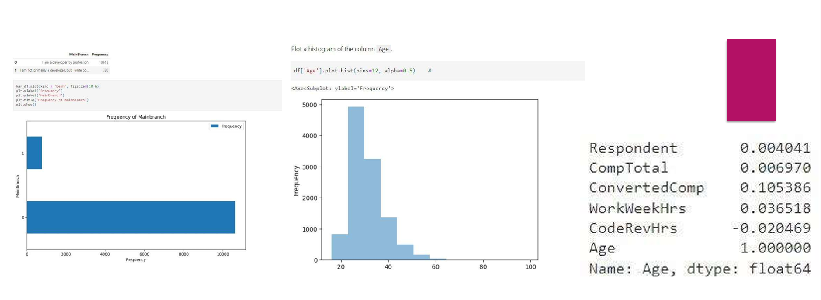
APPENDIX
18

Slide 19
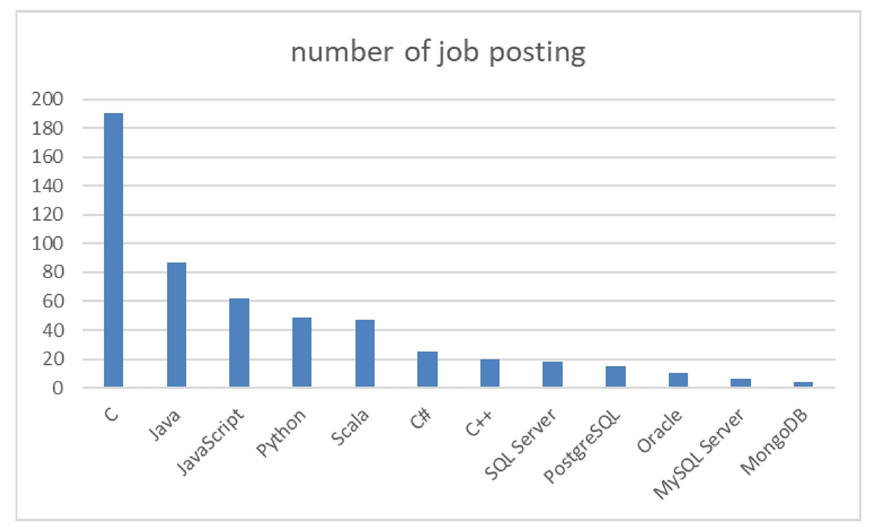
Job postings
Bar chart presenting the job posting data collected using Github Job API.
19

Slide 20
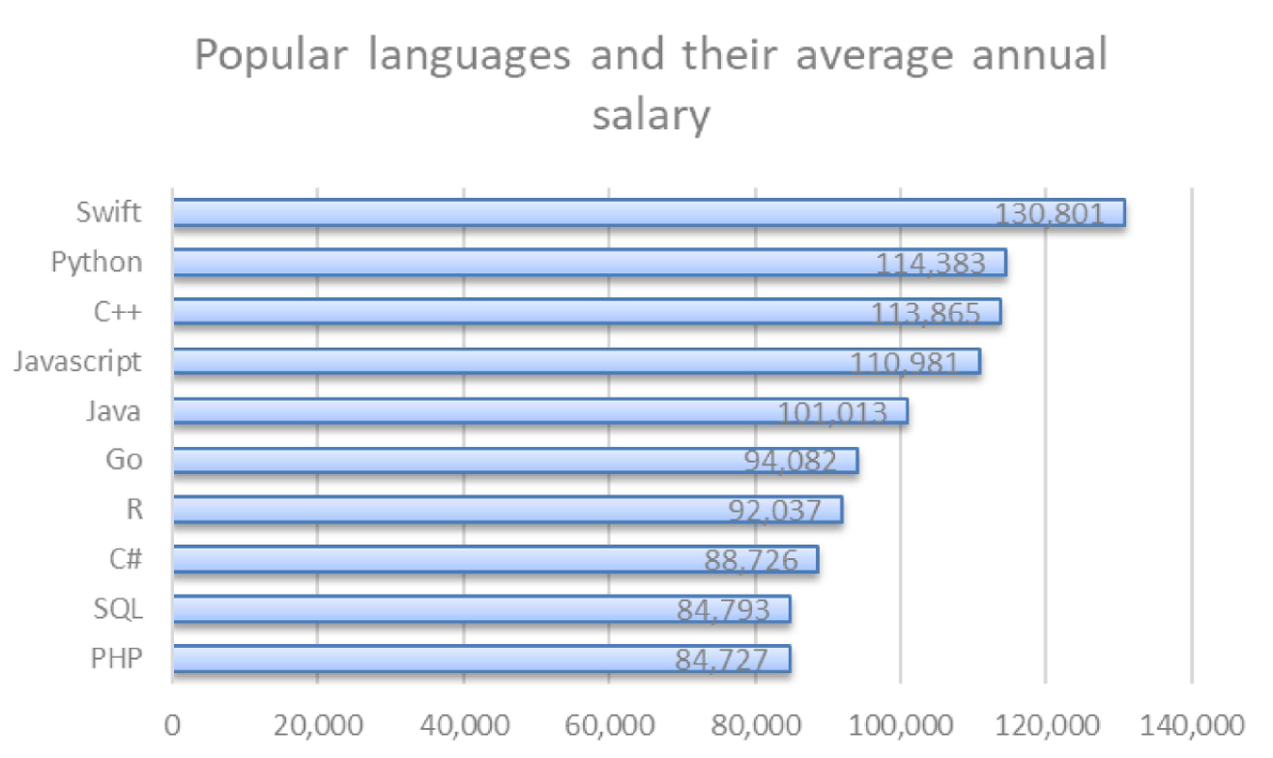
Popular Languages
Bar chart displaying popular languages and their average annual salary. The data was collected through web scraping the Github jobs data and saved in a csv file.
20

